Slide 1
Introduction To Roslyn
Brian Korzynski

Slide 2
About Me
Lead Developer at UseTech Design L.L.C. (UTD)
A consulting firm based in Troy, MI
http://www.utdes.com
Professional Developer for 6+ years
Windows Forms
Web
Mobile
SQL Optimization
Data Analysis
Mathematics
Big Data

Slide 3

What is Roslyn?
Notes:
Rosslyn Church - http://pagepark.co.uk/assets/uploads/projects/xlarge/RC_2_20140410100027.jpg

Slide 4
What is Roslyn?
Definition: the .NET Compiler Platform which provides open-source C# and Visual Basic compilers with rich code analysis API’s.
C# and Visual Basic we built on old technology and just like any code base that has been around for a long time, was getting harder to maintain and add new features.
Microsoft created Roslyn as a way to quickly add new language features and share them across C# and Visual Basic
So they figured why not open source it and make it available to everyone

Slide 5
What does it mean to us?
We can create our own code fixes
We can create our own compiler warnings and errors
We can add our own language features
Don’t recommend doing this unless you are planning to submit a pull request into C# since

Slide 6
What do You Need To Get Started?
Visual Studio 2015 or Visual Studio 2013 with the Roslyn SDK
Be careful with VS 2013 as you can overwrite the compiler
I recommend VS 2015
NuGet Package: Install-Package Microsoft.CodeAnalysis

Slide 7
Where Does the Compiler Fit In
C#
Compiler
DLL/EXE

Slide 8
Nomenclature
Semantics – what is the intent (meaning) of the code
Syntax – rules defined by the compiler (structure of a program)
Symbol – entities such as types, namespaces, members and variables which names and other expressions refer to
Compilation – single project seen by the compiler and represents everything needed to compile an application such as assembly references, compiler options, and the set of source files to be compiled
Binding – the process of associating names and expressions with symbols

Slide 9
NoMenclature – Con’t
Syntax Tree – abstract class with language-specific directives representing an entire parse tree
Syntax Node – class, instances of which represent syntactic constructs such as declarations, statements, clauses, and expressions
Syntax Token – structure representing individual keywords, indentifier, operators, or punctuation
Syntax Trivia – structure representing syntactically insignificant bits of information such as whitespace between tokens, preprocessor directives, and comments
Semantic Model – provides the ability for you to ask questions like the following
What names are in scope at this location?
What members are accessible from this method?
What variables are used in this block of text?

Slide 10
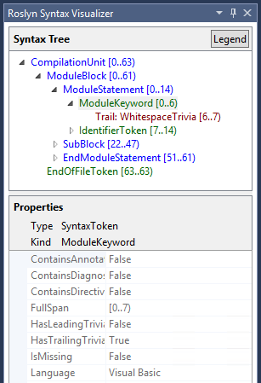
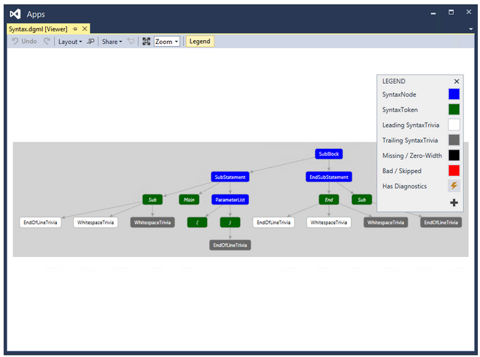
Syntax Visualizer
.Net Compiler Platform Syntax Visualizer - VS Extension

Slide 11
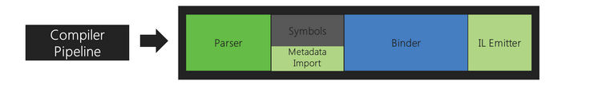
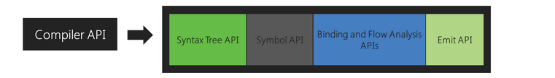

Components

Slide 12
Code Analyzers
Convert your code (string) into components (nodes) that can be manipulated and compiled together to create a working program.
More power/control over doing something like Find and Replace with RegEx

Slide 13
DEMOS

Slide 14
Current Usage
We can create our own code fixes
We can create our own compiler warnings and errors
Write your own code fixes
We can add our own language features

Slide 15
Future Usage
FxCop – flip a flag in the solution and it will automatically throw FxCop errors
Change code to abide by FxCop standards, since some new features are a violation
Allow Pull Requests to the C# language
Compiler as a NuGet package?

Slide 16
Questions
http://www.github.com/korz
@bkorzynski

